Slide 1
FACIAL RECOGNITION WITH MONGODB AND OPENCV: IDENTIFYING PEOPLE IN IMAGES

Slide 2
INTRODUCTION
Connecting to MongoDB
Encoding Person Images
Loading Test Images
Recognizing People in Test Images
Conclusion

Slide 3
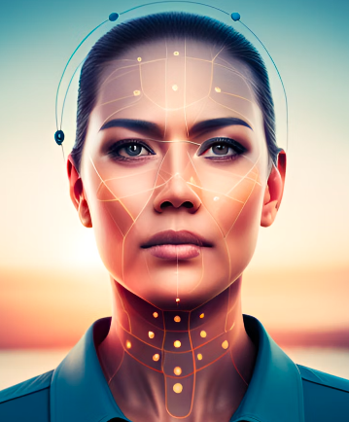
INTRODUCTION
Attempting to make a facial recognition system linked to an optimized data base
To give accurate recognition results in ooptimized time to make it scalable and be able to be deployed in the real world to make a fully functional mobile app which will seamlessly deliver respective person’s image to their destination from all the images captured in an event

Slide 4

CONNECTING TO MONGODB
The 'pymongo' library is used to interact with MongoDB from Python. We can install it using pip by running the command 'pip install pymongo'. Once installed, we can import it in our Python script using 'import pymongo'.
Next, we need to establish a connection to the MongoDB server. We can do this by creating a MongoClient object and passing in the URL of the MongoDB server. This URL typically starts with 'mongodb://' followed by the IP address or hostname of the server, and the port number. For example: 'mongodb://localhost:27017/'. Once we have created the MongoClient object, we can use it to access databases and collections within the database.

Slide 5
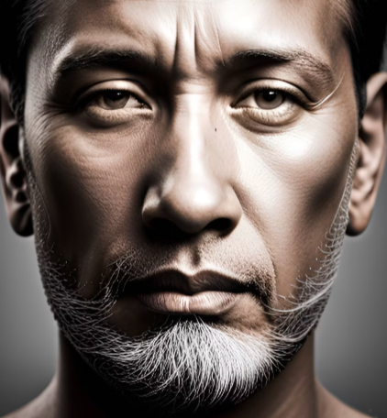
ENCODING PERSON IMAGES
To encode person images using face_recognition, cv2, and numpy. Once we have imported these libraries, we can proceed with encoding the person images.
The next step is to load the images we want to encode using cv2.imread(). We then convert the image to RGB format using cv2.cvtColor() and finally pass it through the face_recognition.face_encodings() function to get the encoded face data. This encoded data can be saved in a database for later use. With these steps, we can successfully encode person images using Python and as it analyzes complete image for detection part and then finding 68 face encodings this part consumes the most of the computational time and the limited resources I had it can’t be optimized further reading almost 60-64 images per second for training.

Slide 6
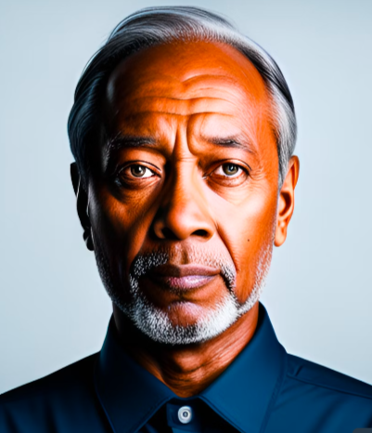
LOADING TEST IMAGES
To load test images for facial recognition, we first need to connect to the MongoDB database using Python. Once connected, we can access the collection where our test images are stored. It's important to load test images from a different collection than the one used for training the facial recognition model. This ensures that the model is tested on new and unseen data, which is crucial for accurate results.
Loading test images involves retrieving the images from the MongoDB collection and converting them into a format that can be processed by the facial recognition algorithm. This can be done using libraries such as OpenCV and NumPy. Once the images are loaded, they can be passed through the facial recognition model to determine if any of the encoded faces match those in the test images.

Slide 7
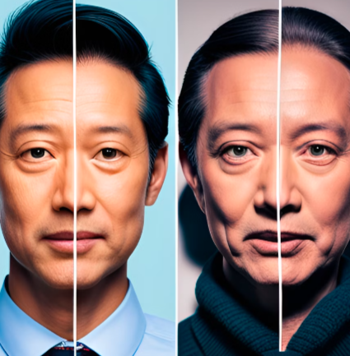
RECOGNIZING PEOPLE IN TEST IMAGES
To recognize people in test images using encoded person images and test images, we will be using the face_recognition, cv2, and numpy libraries in Python.
The first step is to load the encoded person images from the MongoDB collection. Next, we load the test images from a different collection in MongoDB. Finally, we use the face_recognition library to compare the faces in the test images with the encoded person images and identify the person in the image. As we have around 60 facial points per face and the computational power being 10pow8 operations per sec it will take
60*(no. of trained images)/10pow8 sec
To recognize faces in each sec

Slide 8
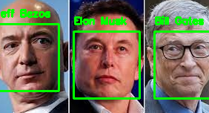
CONCLUSION
With a accuracy of about 95% when tested again random test cases 19 out 20 showed the accurate result and thus reducing the chances of event audiance missing their photos from the event.
Also we will need approx. total photos/60 sec
To do the whole task as the recognizing part
Taking negligible time it can be ignored
Python provides a robust set of libraries for image processing and machine learning, while MongoDB offers a scalable and flexible database solution for storing and retrieving large amounts of data. Together, they form a powerful combination that can be used to develop custom facial recognition solutions tailored to specific business needs.

